Slide 1

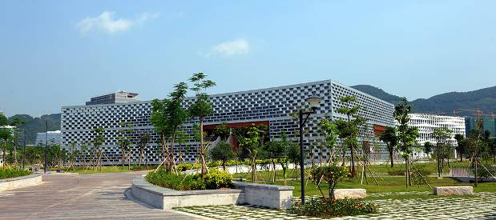
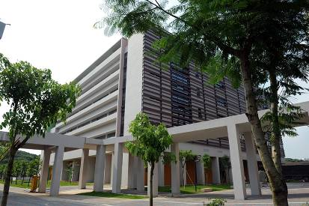
Engineering Electromagnetics 工程电磁场
Youwei Jia 嘉有为

Slide 2

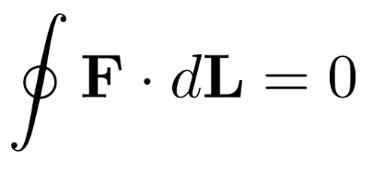
8: Energy and Potential能量与电位
Conservative Field 保守场
A field is conservative if its line integral between any two points is independent of the path chosen. Another property of a conservative field is that its closed path line integral is zero: 场量的线积分与积分路径无关，或者场量的闭合路径积分为零：
Note: Conservative field must be vector field! 保守场一定是矢量场！
Most fields in nature are conservative, such as earth’s gravitational field, electrostatic field...
One can confirm that a field is conservative by evaluating every possible closed path integral and showing a result of zero in all cases. A much faster way, that we will see later, is to evaluate the curl 旋度 of the field. If the curl is zero at all defined points, the field is conservative.
Note: Conservative field must be irrotational field! 保守场一定是无旋场！
22

Slide 3
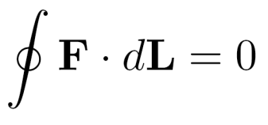
8: Energy and Potential能量与电位
Conservative Force 保守力
A conservative force is a force with the property that the work done in moving a particle between two points is independent of the taken path. Equivalently, if a particle travels in a closed loop, the net work done by a conservative force is zero.
Note: In other words, the force involved in conservative field is conservative force,
and sometimes, conservative field is also termed as ‘conservative force field’.
23

Slide 4
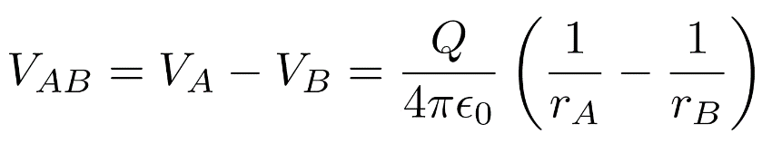
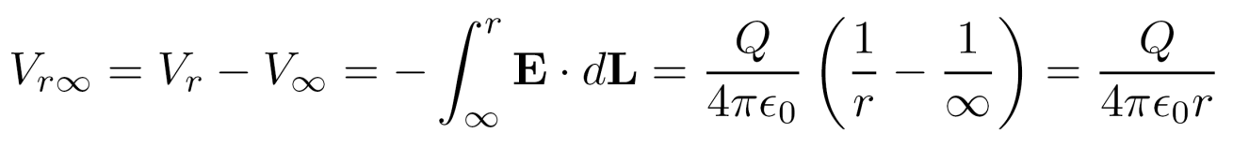
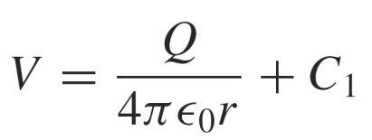
8: Energy and Potential能量与电位
Potential Field of a Point Charge 点电荷的电位场
We just found the difference in potential between two positions in a point charge field:
We could perform the same calculation by specifying the starting point at infinity, and the ending point at some general radius, r:
This result is a potential function or potential field, which specifies potential at any position within the defined space, and with the potential at infinity (the reference value) equal to zero.
In practice, we can “bias” this function any way we want (or need) to, by an additive constant, C₁:
24

Slide 5
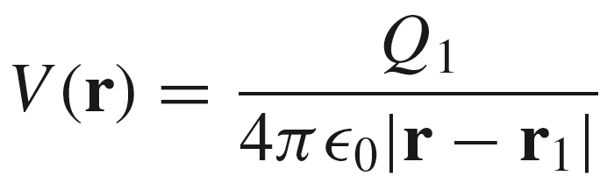
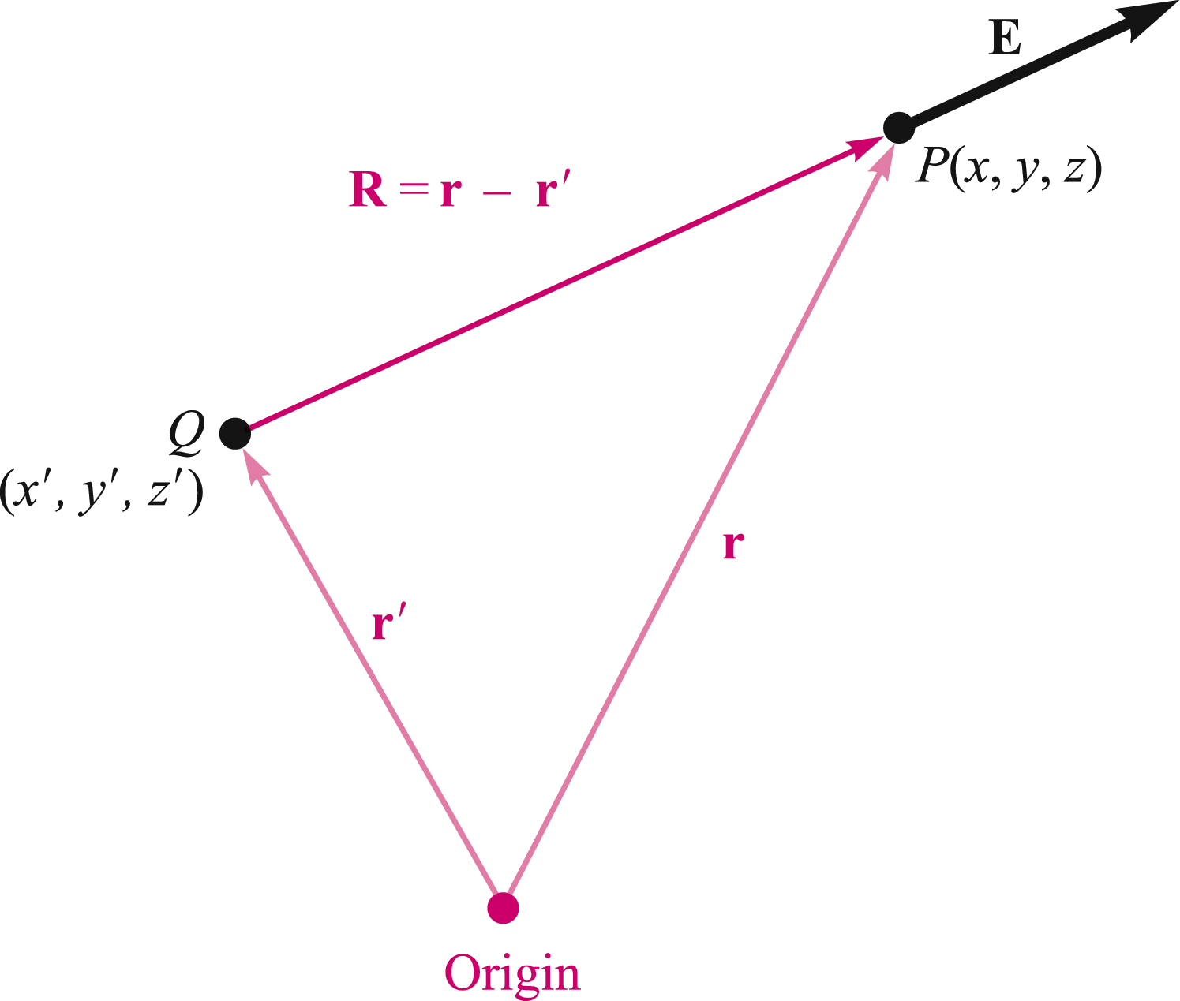
8: Energy and Potential能量与电位
Potential Field of a Point Charge Off-Origin
The setup here is the same as what we used
in writing the electric field of an off-origin
point charge.
P
1
We now define an equipotential surface as a surface composed of all those points having the same value of potential.
The equipotential surfaces in the potential field of a point charge are spheres centered at the point charge.
1
1
1
1
1
25

Slide 6
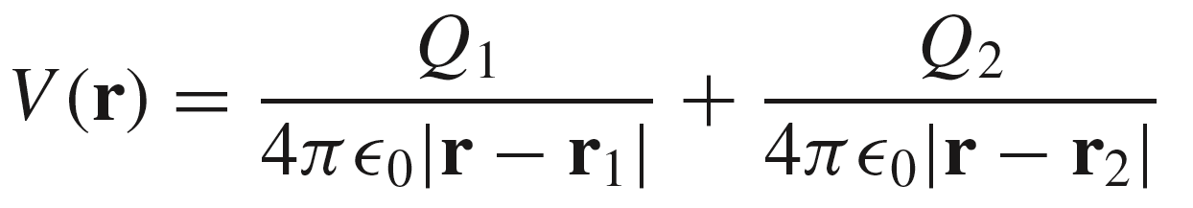
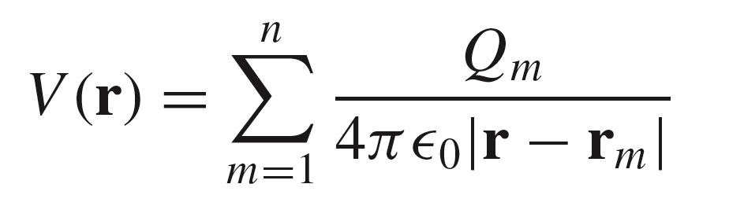
8: Energy and Potential能量与电位
Potential Field Arising From Two or More Point Charges
Introduce a second point charge, and the two scalar potentials simply add:
For n charges, the process continues:
26

Slide 7
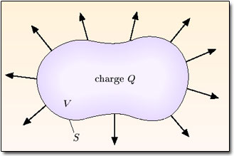
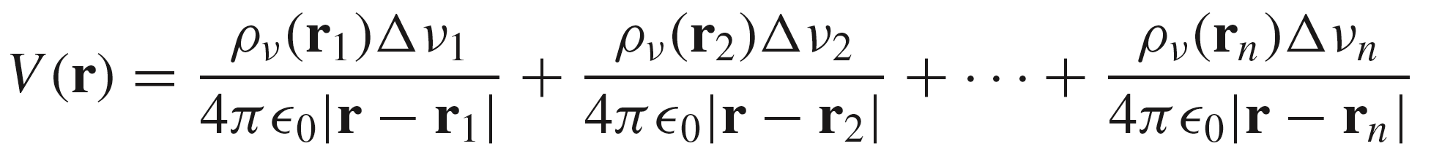
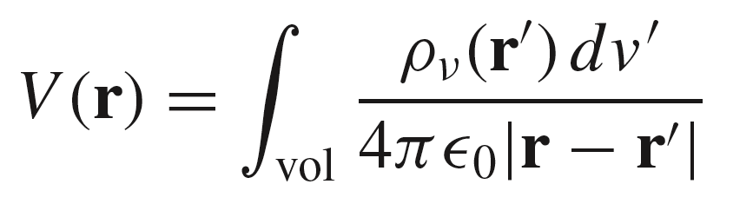
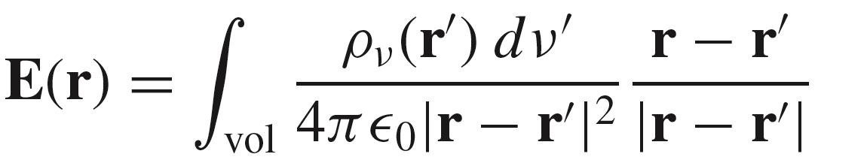
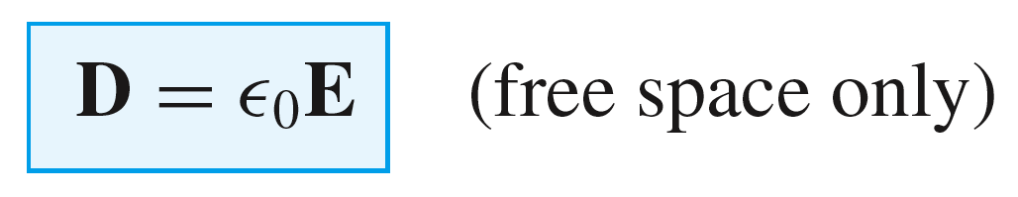
8: Energy and Potential能量与电位
Potential Associated with Continuous Charge Distributions
As we allow the number of elements to become infinite, we obtain the integral expression:
27

Slide 8
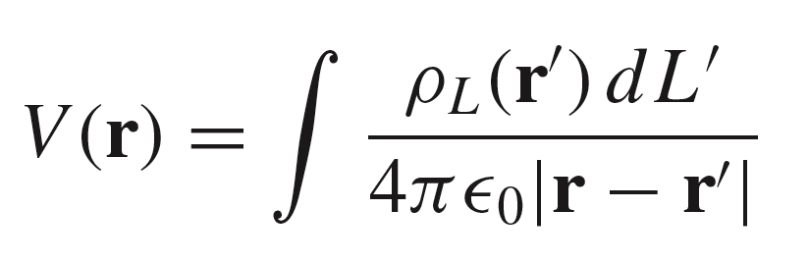
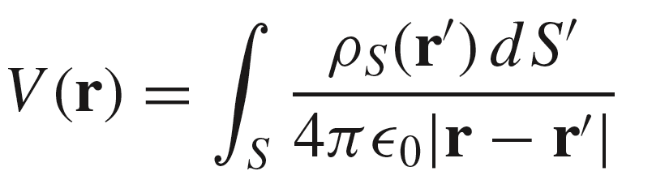
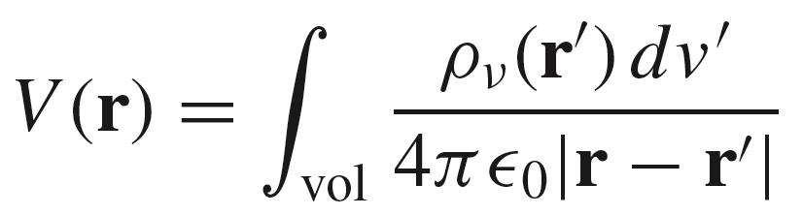
8: Energy and Potential能量与电位
Potential Functions Associated with Line, Surface, and Volume Charge Distributions
Line Charge:
Surface Charge:
Volume Charge:
28

Slide 9
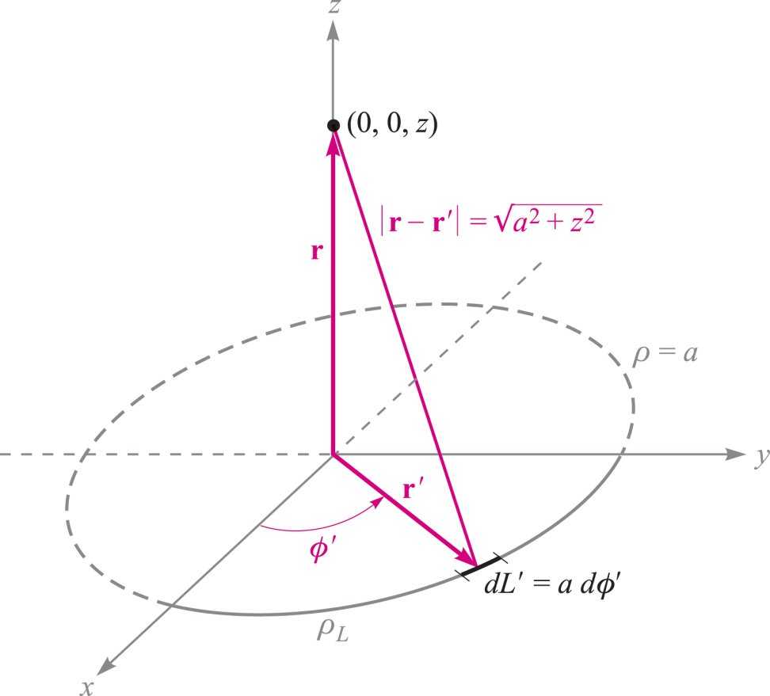

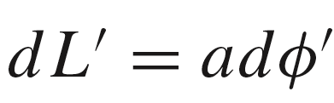


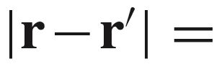
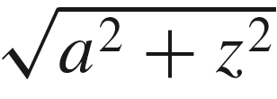
8: Energy and Potential能量与电位
Example
The problem is to find the potential anywhere on the z axis arising from a circular ring of charge in the x-y plane, centered at the origin.
We use:
with
29

Slide 10

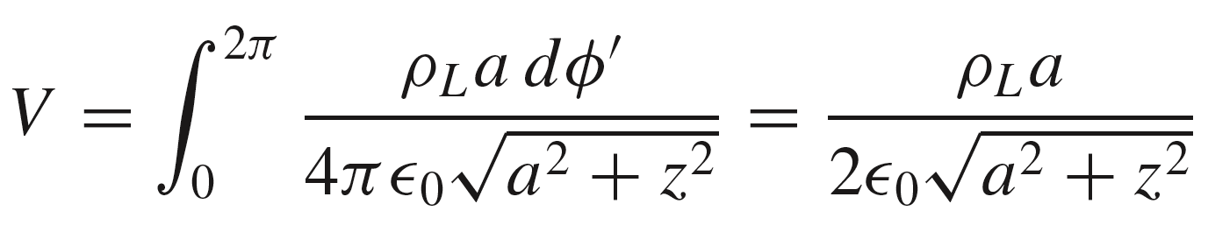


8: Energy and Potential能量与电位
Example (Cont’d)
So now
becomes:
where
30

Slide 11
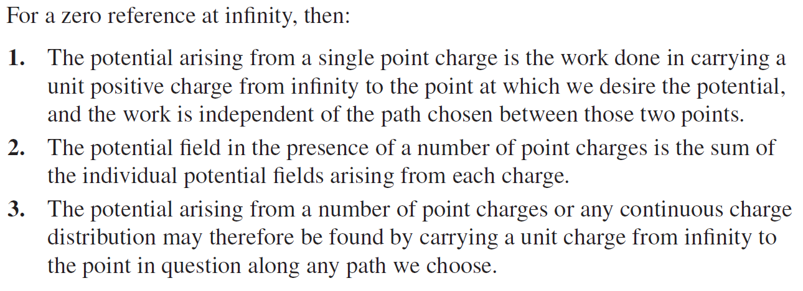
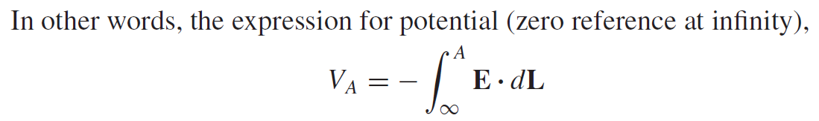
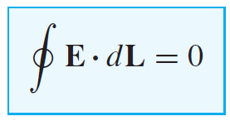
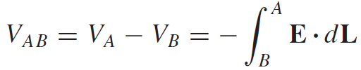
8: Energy and Potential能量与电位
Summary
31

Slide 12
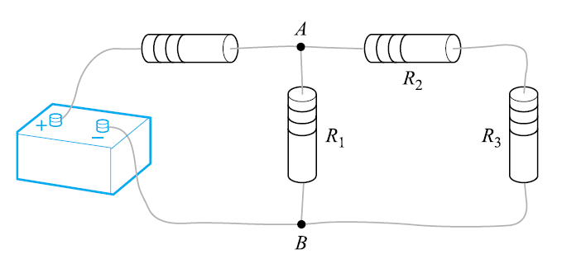
8: Energy and Potential能量与电位
Summary
Kirchhoff’s circuital law for voltages
32

Slide 13
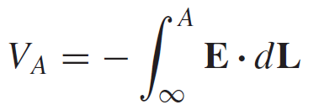
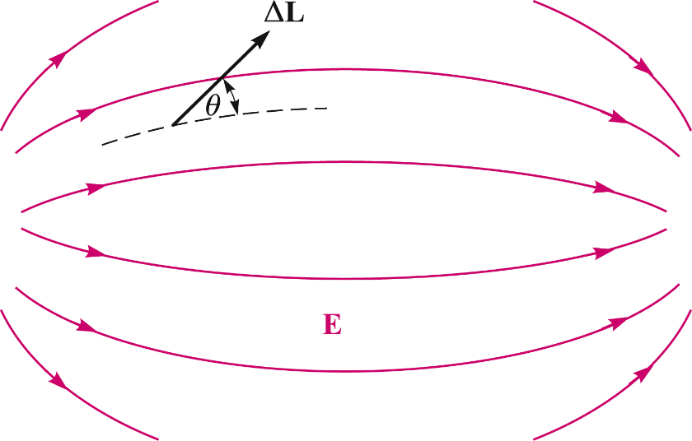
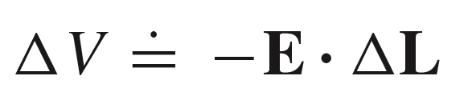
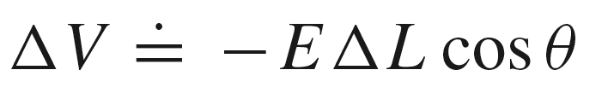
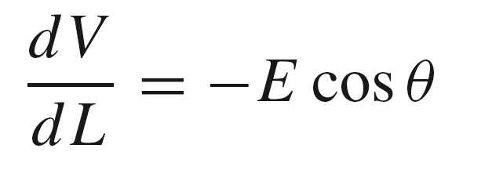
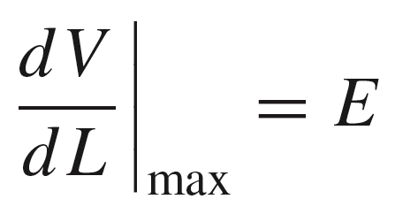
8: Energy and Potential能量与电位
Change in Potential over an Incremental Distance
The change in potential occurring over distance
ΔL depends on the angle between this vector and
the electric field; i.e., the projection of the field
along the path:
or
from which:
whose maximum value is:
when the path vector lies along the electric field direction.
33

Slide 14
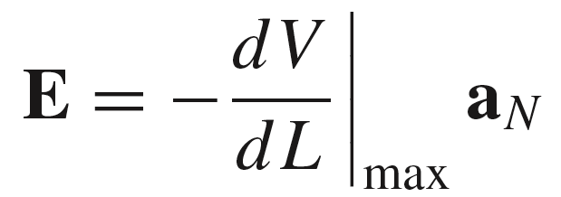
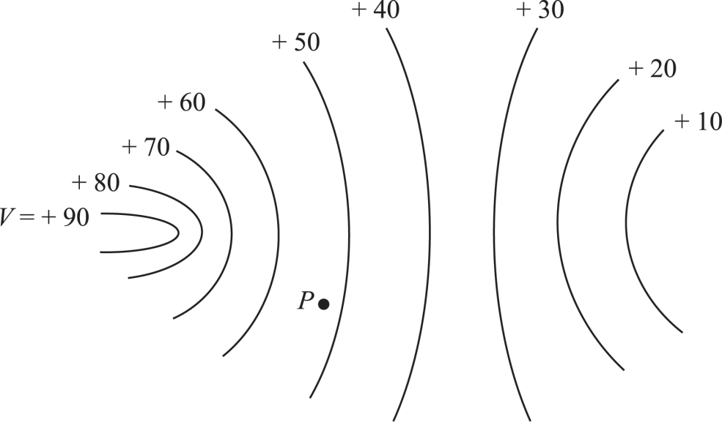
8: Energy and Potential能量与电位
Relation Between Potential and Electric Field
The maximum rate of increase in potential should occur in a direction exactly opposite the electric field:
unit vector normal to an equipotential
surface and in the direction of increasing
potential
Equipotential surfaces
E points in the direction
of maximum rate of decrease
in potential -- in the direction
of the negative gradient of V.
a_{N}
E
负梯度
34

Slide 15
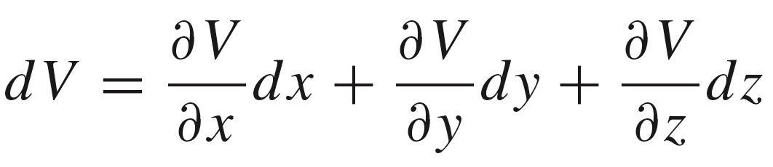
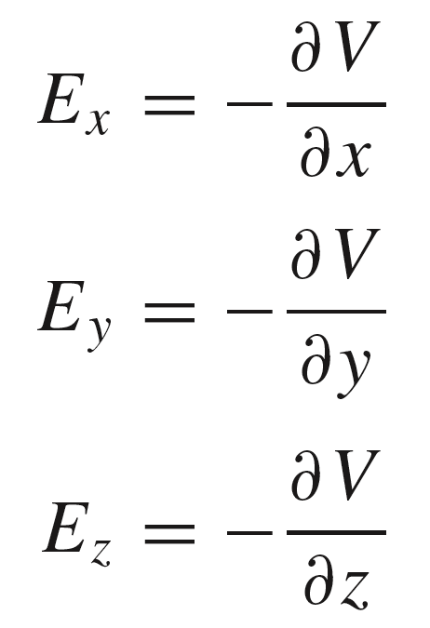
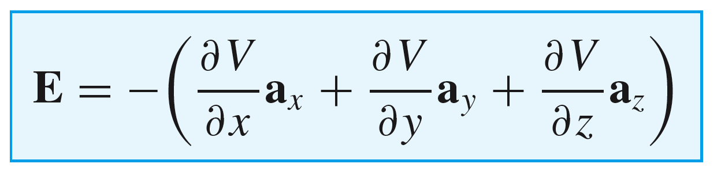
8: Energy and Potential能量与电位
Electric Field in Terms of V in Rectangular Coordinates
We also know that:
We therefore identify:
So that:
35

Slide 16
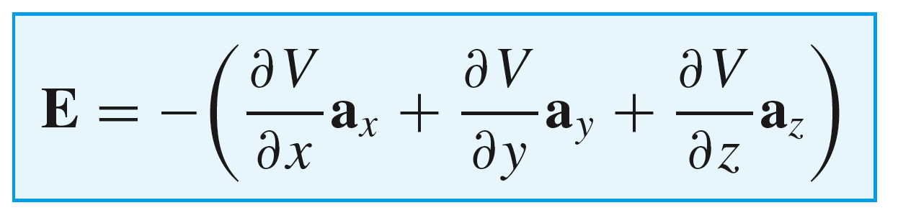
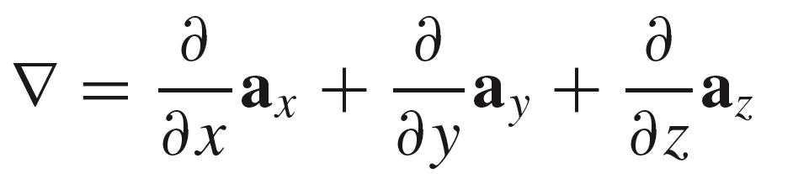
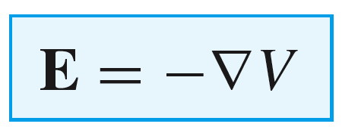
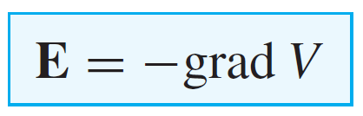
8: Energy and Potential能量与电位
Electric Field in Terms of V in Rectangular Coordinates
This is obtained by using the del operator,
on V
A more compact relation therefore emerges, which is applicable to static electric fields:
E is equal to the negative gradient of V
The direction of the gradient is that of the maximum rate of increase in the scalar field, or normal to all equipotential surfaces.
Note: 1) The gradient of a scalar is a vector!
2) Any gradient field is conservative field, or irrotational field.
36

Slide 17
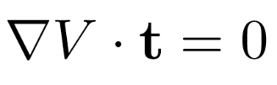


8: Energy and Potential能量与电位
Direction of the Gradient Vector
The projection of the gradient along a direction tangent to an equipotential surface must give a result of zero, as the potential by definition is constant along that surface: In other words,
Therefore, must be perpendicular to t, or normal to an equipotential surface, and in the direction of maximum increase in V.
t
E
37

Slide 18
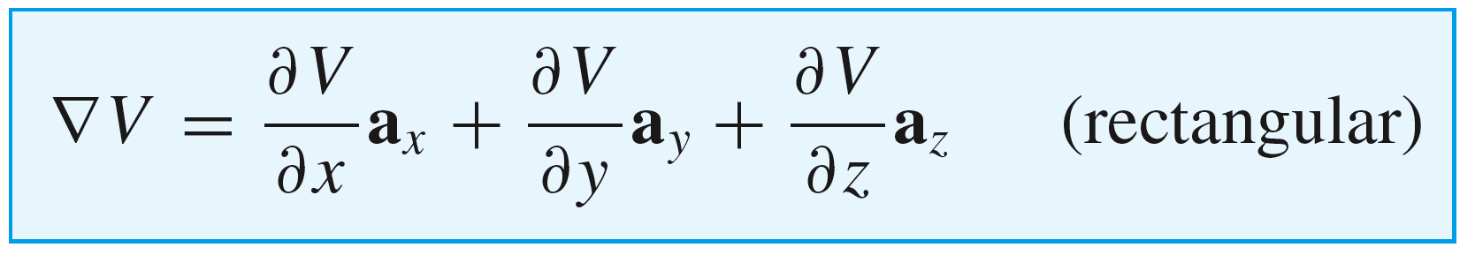
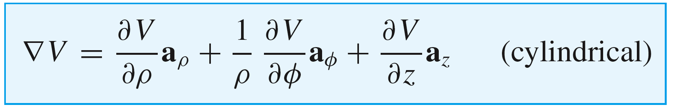
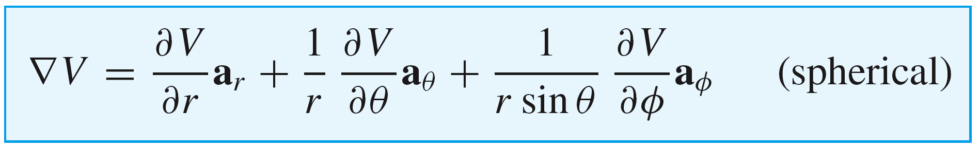
8: Energy and Potential能量与电位
Gradient of V in the Three Coordinate Systems
38

Slide 19
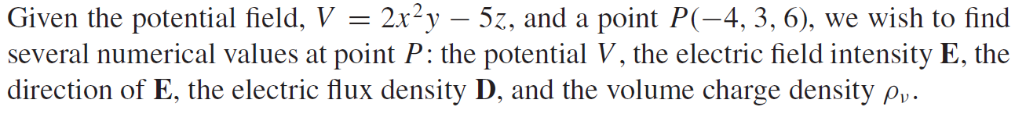
8: Energy and Potential能量与电位
Example
39

Slide 20
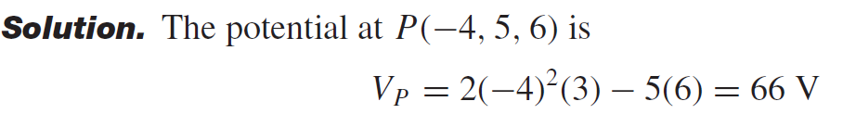



8: Energy and Potential能量与电位
Example
39

Slide 21

8: Energy and Potential能量与电位
Example (Cont’d)
2
40

Slide 22


8: Energy and Potential能量与电位
Electric Dipole 电偶极子
An electric dipole, or simply a dipole, is the name given to two point charges of equal magnitude and opposite sign, separated by a distance that is small compared to the distance to the point P at which we want to know the electric and potential fields.
The potential will be just the sum of
the two potential functions associated with each point charge:
41

Slide 23




8: Energy and Potential能量与电位
Far-Field Approximation 远场近似
Under the condition r >>d, the three
position vectors are approximately
parallel.
This means that we may use the
approximations:
and
to get finally:
42

Slide 24




8: Energy and Potential能量与电位
Electric Field of the Dipole
or..
from which finally:
43

Slide 25

8: Energy and Potential能量与电位
Electric Dipole Field and Equipotentials
Equipotential surface
Electric field streamline
44

Slide 26







8: Energy and Potential能量与电位
Electric Dipole Moment 偶极矩
The dipole moment vector is directed from the negative charge to the positive charge, and is defined as:
In the charge configuration we have used, the direction of p is a_{z} , and therefore:
so we may write:
which would account for any orientation of p.
or in general, for a dipole at any orientation, positioned off-origin:
45

Slide 27

8: Energy and Potential能量与电位
Potential Energy in a System of Two Point Charges
Q₁
Q₂
+
R_{2,1}
+
Charge Q₂ is brought into
position from infinity.
Q₁ has zero energy if isolated
The work done in bringing Q₂ into position is:
This is the stored energy in the “system”, consisting of the two assembled charges.
46

Slide 28



8: Energy and Potential能量与电位
Potential Energy in a System of Three Point Charges
Q₁
Q₂
+
R_{2,1}
+
R_{3,2}
Charge Q₃ is brought into
position from infinity, with
Q₁ and Q₂ already situated.
R_{3,1}
+
Q₃
The system energy is now the previous 2-charge energy plus the work done in bringing Q₃ into position:
Where
and
47

Slide 29



8: Energy and Potential能量与电位
Potential Energy in a System of Four Point Charges
Charge Q₄ is brought into
position from infinity, with
Q₁, Q₂, and Q₃ already situated.
Q₁
Q₂
+
R_{2,1}
+
Q₄
R_{4,1}
R_{4,2}
R_{3,1}
R_{3,2}
+
R_{4,3}
+
It’s getting complicated!
Q₃
The system energy is now the previous 3-charge energy plus the work done in bringing Q₄ into position:
where
and
48

Slide 30


8: Energy and Potential能量与电位
Potential Energy in a System of Four Point Charges
Q₁
Q₂
+
R_{2,1}
+
Q₄
R_{4,1}
R_{4,2}
R_{3,1}
R_{3,2}
+
R_{4,3}
+
Q₃
49

Slide 31





8: Energy and Potential能量与电位
Condensed Expression for the Stored Energy in an Assembly of Point Charges
Define the “local” potentials:
Q₁
Q₂
+
R_{2,1}
+
Q₄
R_{4,1}
R_{4,2}
R_{3,1}
R_{3,2}
+
R_{4,3}
+
Q₃
..so that
50

Slide 32


8: Energy and Potential能量与电位
Potential Energy in a System: Extension to an n-Charge Ensemble
Extending the previous result, we can write the energy expression for n charges:
where the local potential
(at the position of charge m) is:
Note that this is the potential due to all charges except charge m, evaluated at the location of charge m.
51

Slide 33


8: Energy and Potential能量与电位
Stored Energy in a Continuous Charge Distribution
If we have a continuous charge, characterized by a charge density function, we use implicitly the expression
but the charge Q is replaced by the quantity dq = ρ_{v} dv, and the summation becomes an integral over the charge volume:
where V is the position-dependent potential function within the charge volume.
52

Slide 34




8: Energy and Potential能量与电位
Stored Energy in the Electric Field
We use Maxwell’s first equation to express volume charge density in terms of D:
where the vector identity, , has been used.
Next, the divergence theorem is used on the first term, replacing the volume integral by an integral over the surface that surrounds the volume:
53

Slide 35



8: Energy and Potential能量与电位
Stored Energy in the Electric Field
We now have:
in which the region of integration now includes all space, or wherever the field and potential exist.
At the infinite distance, the potential and D fields begin to resemble those of a point charge:
and therefore:
This means that the surface integral will vanish, because the inverse cube dependence in the integrand falls off at a more rapid rate with r than the surface area increases (surface area increases only as the square of the radius).
54

Slide 36




8: Energy and Potential能量与电位
Electric Field Energy and Energy Density
The field energy expression now reads:
but we know that:
which leads us to the final result:
where the energy density in the
electric field is defined as:
55

Slide 37


HW-4
56

